Slide 1

REGRESI LOGISTIK dengan PYTHON
Dwilaksana Abdullah Rasyid

Slide 2
S1 STATISTIKA ITS 2014-2018
Volunteer Staff UBER Surabaya, 2016
Bussiness Intelligence PDAM Surabaya, 2018
Digitalent Schoolarship Batch 1 2018
S2 STATISTIKA ITS
Advocation Staff DSI East Java Region
….
https://www.linkedin.com/in/dwilaksana-abdullah-rasyid-b55966b8/

Slide 3
Required library
pandas
numpy
matplotlib
seaborn
tweepy
Imbalanced-learn
scikit-learn

Slide 4
Social Media Crawling

Slide 5
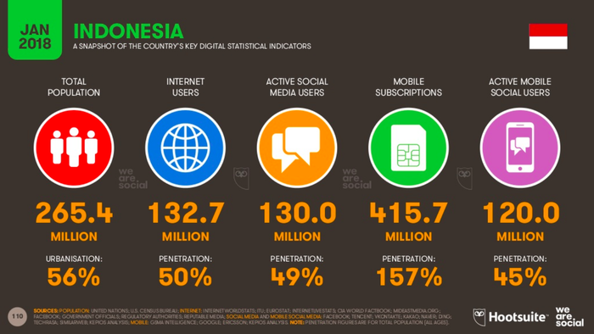
Media Sosial di Indonesia

Slide 6
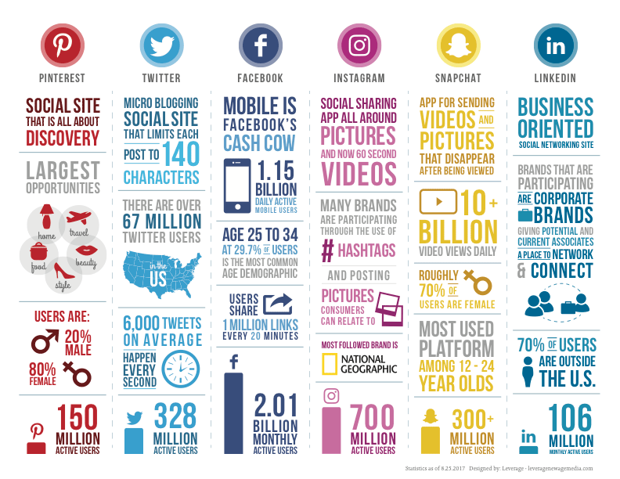
Media Sosial sebagai Big Data

Slide 7
Tantangan Media Sosial di Big Data
Pertumbuhannnya sangan cepat
Data tidak terstruktur
Data kurang terkontrol
Real time

Slide 8
Riset Media Sosial di Big data
Sentiment analysis
Mengetahui reaksi netizen terhadapat sesuatu
Tracking user behavior
Mengidentifikasi kegiatan netizen
Social Network Analysis
Mengetahui hubungan antar netizen
Popularity
Mengetahui kepopuleran di dunia maya

Slide 9
Data dari Media Sosial
Pertemanan
Status
Komentar
Reaksi : Likes, Favorite, Share dll
Lokasi

Slide 10
Open Authentication
OAuth telah diluncurkan sebagai cara standar dan praktik terbaik untuk aplikasi dan situs web untuk menangani otentikasi. OAuth adalah protokol terbuka untuk mengizinkan otorisasi Application Programming Interfaces (API) yang aman dari desktop dan aplikasi web melalui metode yang sederhana dan standar.
Mengatur handshake di antara aplikasi dan digunakan ketika penerbit API ingin tahu siapa yang berkomunikasi dengan sistem.
Banyak penerbit API terbesar telah menerapkan OAuth untuk menangani akses write ke API mereka.

Slide 11
Oauth Twitter
User authentication aka user context
Sebagai user saja seperti update status, reply
Yang dibutuhkan adalah :
consumer key dan secret dari Twitter app
the access token dan access token secret dari user
Application-only authentication aka app only
Dapat mengakses informasi publik secara real time
Yang dibutuhkan adalah bearer token

Slide 12
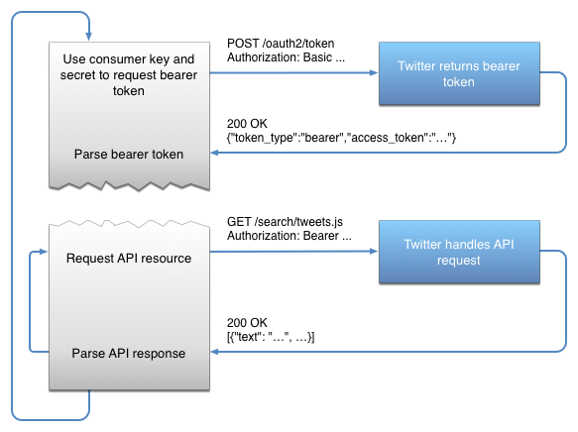
Application-only authentication
https://developer.twitter.com/en/docs/basics/authentication/overview/application-only

Slide 13
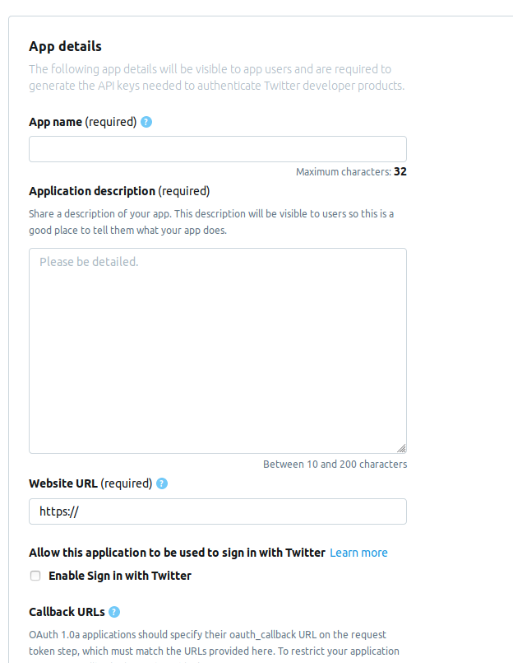
https://developer.twitter.com/en/apps

Slide 14
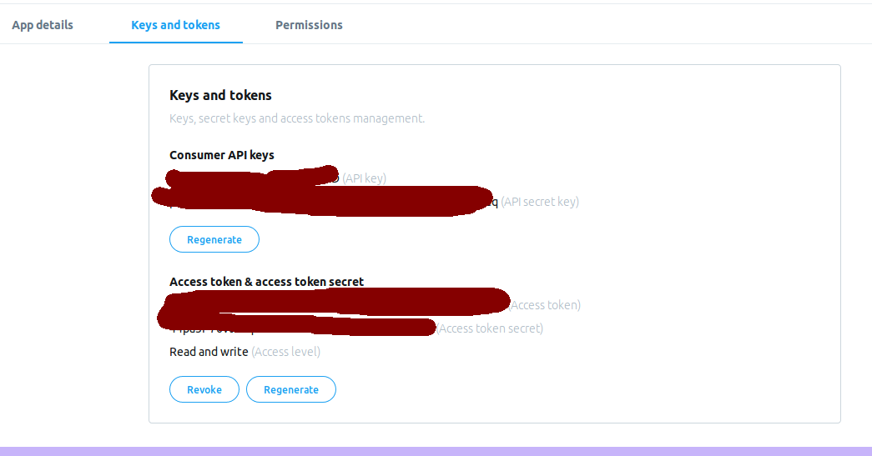
Key dan tokens Twitter

Slide 15
JSON
JavaScript Object Notation (JSON) - http://json.org
data yang ringan dan mudah dipertukarkan
mudah bagi manusia untuk membaca dan menulis
mudah bagi mesin untuk mem-parsing dan menghasilkan format teks
bahasa program independen
https://jsoneditoronline.org/

Slide 16
Contoh JSON pada Twitter
{ "created_at": "Thu May 10 17:41:57 +0000 2018", "id_str": "994633657141813248", "text": "Just another Extended Tweet with more than 140 characters, generated as a documentation example, showing that [\"tru… https://t.co/U7Se4NM7Eu", "display_text_range": [0, 140], "truncated": true, "user": { "id_str": "944480690", "screen_name": "FloodSocial" }, "extended_tweet": { "full_text": "Just another Extended Tweet with more than 140 characters, generated as a documentation example, showing that [\"truncated\": true] and the presence of an \"extended_tweet\" object with complete text and \"entities\" #documentation #parsingJSON #GeoTagged https://t.co/e9yhQTJSIA", "display_text_range": [0, 249], "entities": { "hashtags": [{ "text": "documentation", "indices": [211, 225] }, { "text": "parsingJSON", "indices": [226, 238] }, { "text": "GeoTagged", "indices": [239, 249] }] } }, "entities": { "hashtags": [] } }

Slide 17
http://www.tweepy.org/
Library Python untuk akses Twitter

Slide 18
Hello Tweepy
import tweepy
consumer_key = ‘XXX'
consumer_secret = ‘XXX'
access_token = ‘XXX'
access_token_secret = ‘XXX'
auth = tweepy.OAuthHandler(consumer_key, consumer_secret)
auth.set_access_token(access_token, access_token_secret)
api = tweepy.API(auth)
public_tweets = api.home_timeline()
for tweet in public_tweets:
print(tweet.text)

Slide 19
Hello Ocid
import tweepy
consumer_key = ‘XXX'
consumer_secret = ‘XXX'
access_token = ‘XXX'
access_token_secret = ‘XXX'
auth = tweepy.OAuthHandler(consumer_key, consumer_secret)
auth.set_access_token(access_token, access_token_secret)
api = tweepy.API(auth)
user = api.get_user(‘ocetdwi')
print (user.screen_name)
print (user.followers_count)
for friend in user.friends():
print(friend.screen_name)

Slide 20
Tweepy API
https://tweepy.readthedocs.io/en/v3.6.0/api.html
API.home_timeline
API.statuses_lookup
API.user_timeline(
Dst

Slide 21
Tweepy Search API
search_results = api.search(q=“Avengers endgame", count=100)
for tweet in search_results:
print(tweet)

Slide 22
Tweepy Search API
search_results = api.search(q=“katie bouman", count=100)
for tweet in search_results:
print("user: "+tweet.author.screen_name)
print("status: "+tweet.text)

Slide 23
Tweepy + Pandas
import pandas as pd
search_results = api.search(q=“iron man dead", count=100)
datatw = pd.DataFrame()
datatw["text"] = [tweet.text.lower() for tweet in search_results]
datatw["created_at"] = [tweet.created_at for tweet in search_results]
datatw["retweet_count"] = [tweet.retweet_count for tweet in search_results]
datatw["user_screen_name"] = [tweet.author.screen_name for tweet in search_results]
datatw["user_followers_count"] = [tweet.author.followers_count for tweet in search_results]
datatw["country"] = [tweet.author.location for tweet in search_results]

Slide 24
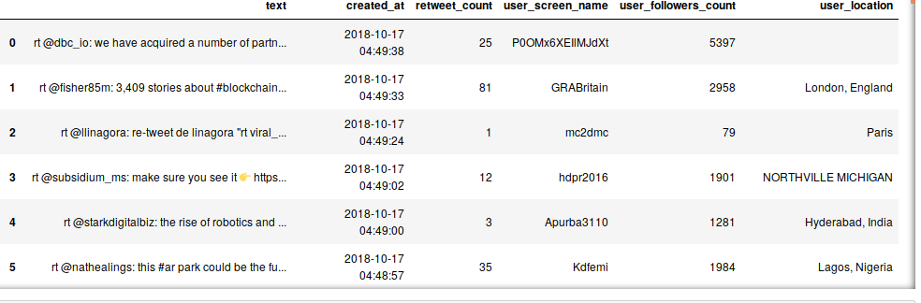
Tweepy + pandas (2)

Slide 25
Tweepy + CSV
import pandas as pd
search_results = api.search(q=“hail hydra", count=100)
datatw = pd.DataFrame()
datatw["text"] = [tweet.text.lower() for tweet in search_results]
datatw["created_at"] = [tweet.created_at for tweet in search_results]
datatw["retweet_count"] = [tweet.retweet_count for tweet in search_results]
datatw["user_screen_name"] = [tweet.author.screen_name for tweet in search_results]
datatw["user_followers_count"] = [tweet.author.followers_count for tweet in search_results]
datatw["user_location"] = [tweet.author.location for tweet in search_results]
datatw.to_csv("bigdata.csv")

Slide 26
Streaming Tweepy
Digunakan untuk mengambil status secara realtime
API berdasarkan https://developer.twitter.com/en/docs/tweets/filter-realtime/overview
3 langkah streaming
Buat class yang diturunkan dari StreamListener
Gunakan class tersebut untuk membuat Stream object
Hubungkan dengan Twitter API dengan menggunakan Stream.

Slide 27
Streaming Tweepy (2)
import tweepy
consumer_key = ‘XXX'
consumer_secret = ‘XXX'
access_token = ‘XXX'
access_token_secret = ‘XXX'
auth = tweepy.OAuthHandler(consumer_key, consumer_secret)
auth.set_access_token(access_token, access_token_secret)
api = tweepy.API(auth)

Slide 28
Streaming Tweepy (3)
class StreamListener(tweepy.StreamListener):
def on_status(self, status):
print(status.text)
def on_error(self, status_code):
if status_code == 420:
return False
stream_listener = StreamListener()
stream = tweepy.Stream(auth=api.auth, listener=stream_listener)
stream.filter(track=["jokowi", "prabowo"])

Slide 29
Deepdown Machine Learning

Slide 30
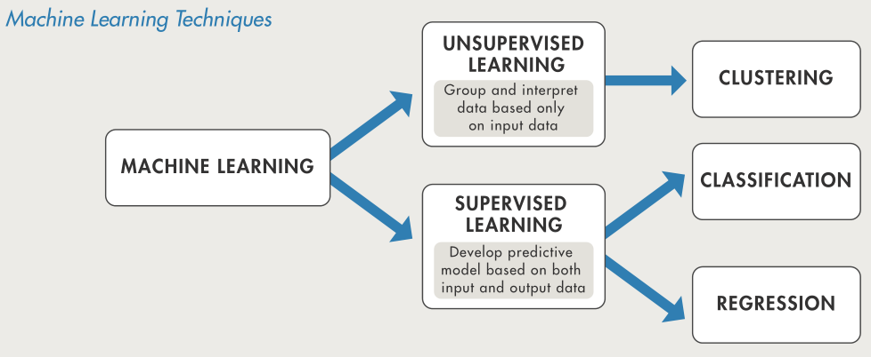
Supervised learning, yang melatih model dengan input dan output data yang dikenal, sehingga dapat memprediksi masa depan output
Unsupervised learning, yang menemukan pola-pola yang tersembunyi atau struktur intrinsik dalam input data

Slide 31
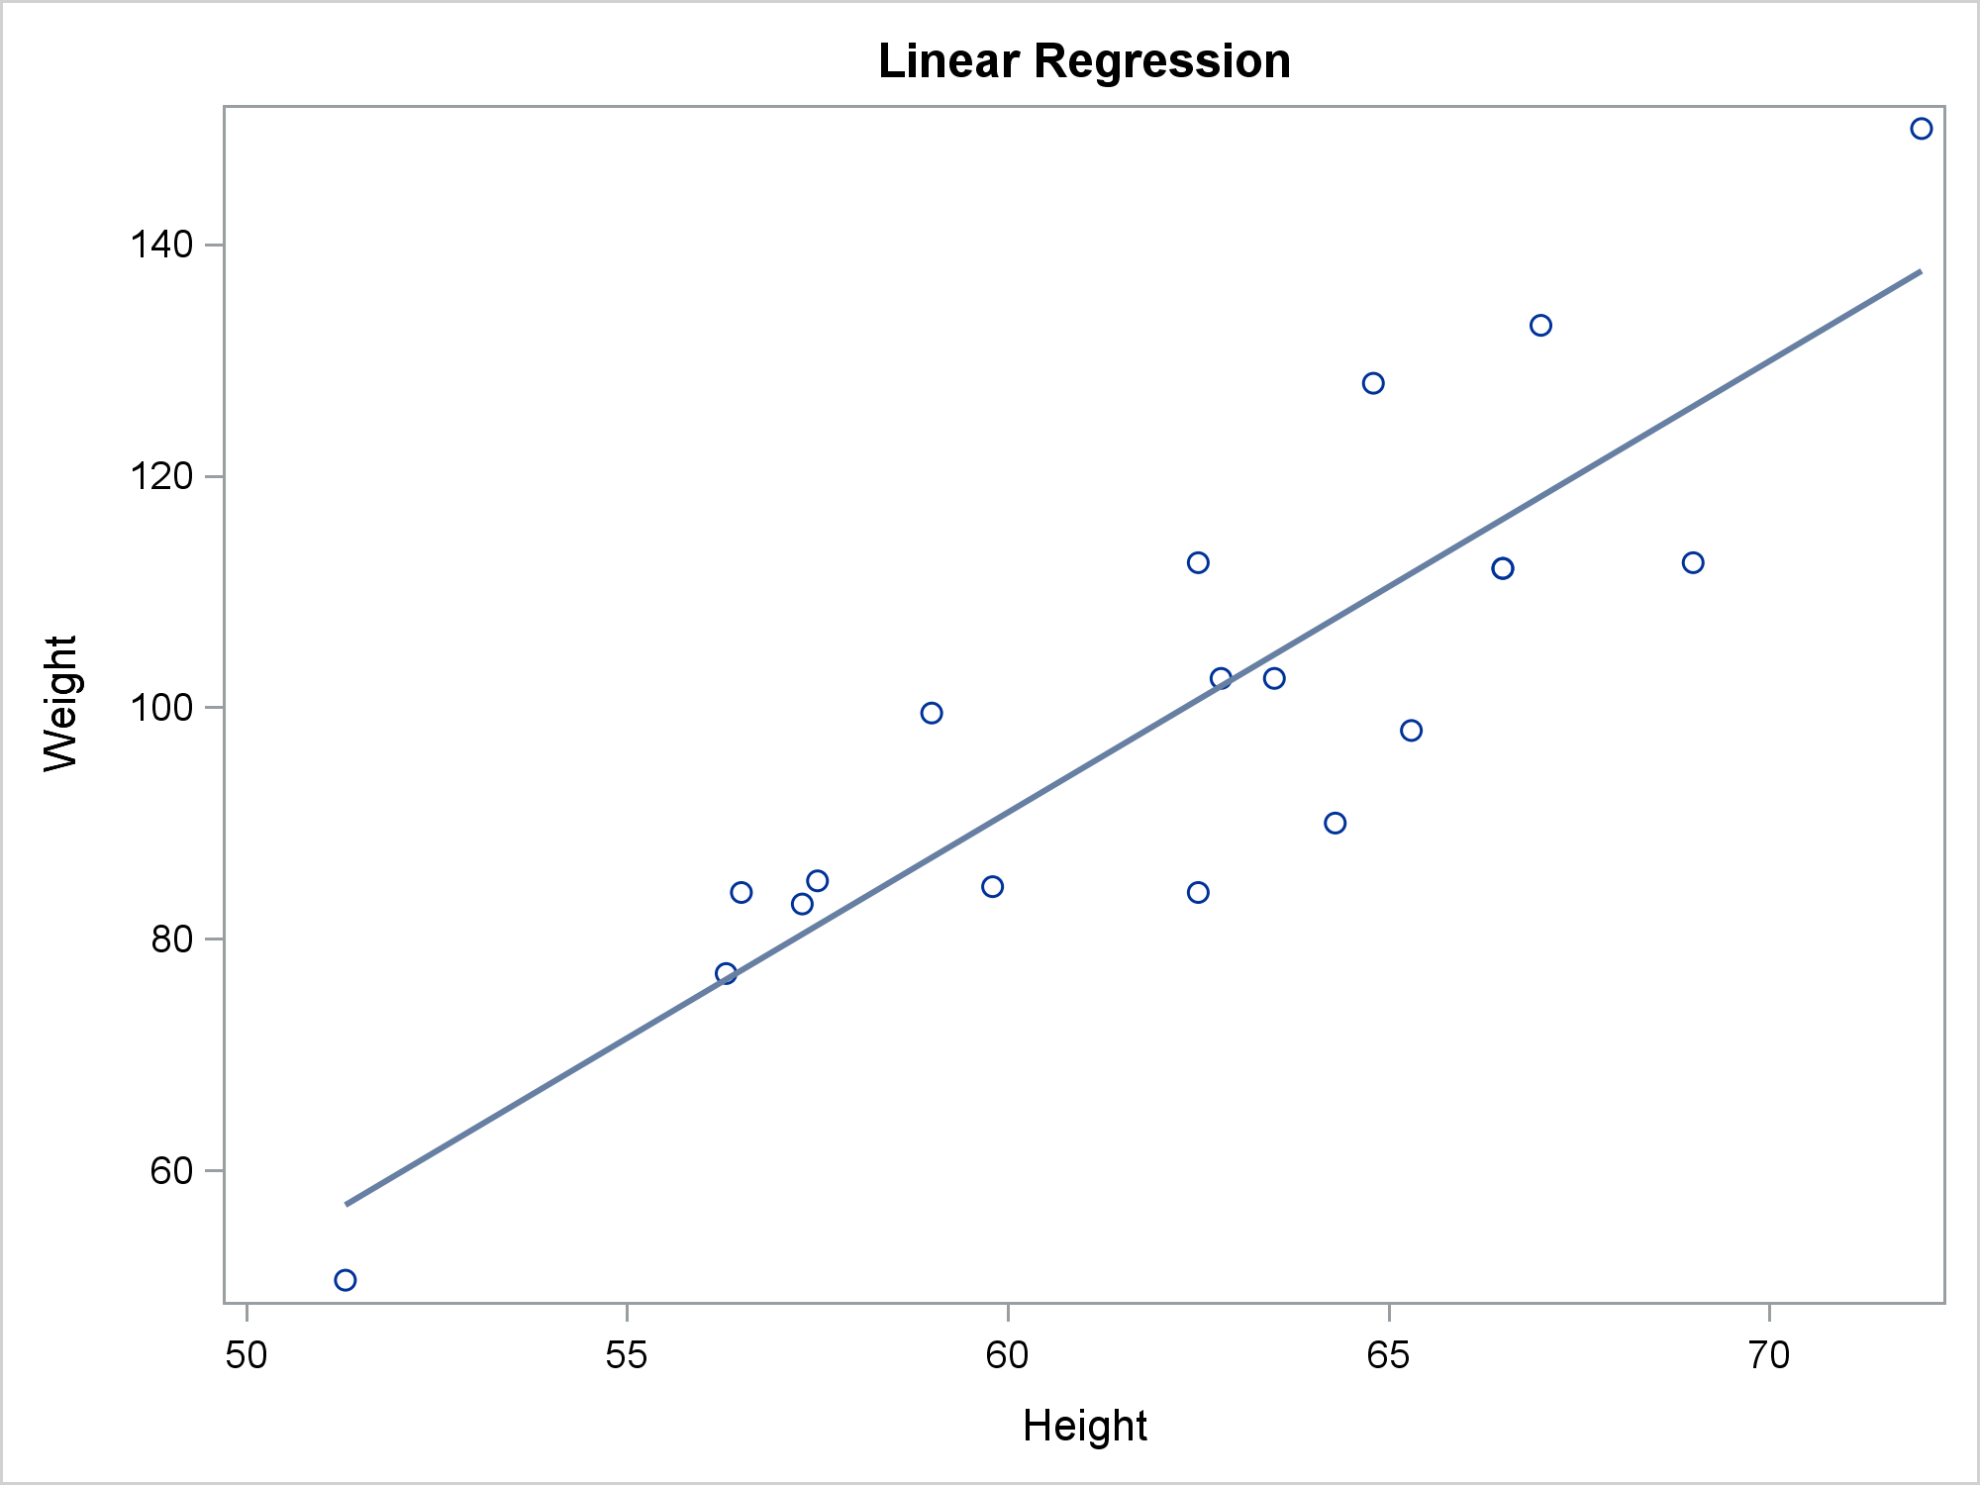
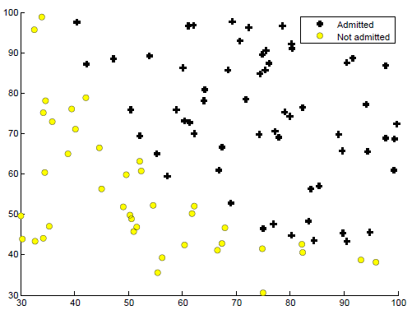
Machine Learning
Analytics
Umumnya mesin learning dibagi kedalam 4 bagian, yakni supervised learning, unsupervised learning, reinforcement learning, dan asosiasi rule.
Regresi adalah metode yang digunakan untuk memprediksi berdasarkan data yang telah ada. Hal tersebut membuat regresi mempunyai syarat bahwa variabel Y nya bertipe kontinu.
Sedangkan klasifikasi adalah melakukan prediksi berupa kategorikal data berdasarkan data yang telah ada.
Regresi
Klasifikasi

Slide 32
Telco Data Description
The data set includes information about:
Customers who left within the last month – the column is called Churn
Services that each customer has signed up for – phone, multiple lines, internet, online security, online backup, device protection, tech support, and streaming TV and movies
Customer account information – how long they’ve been a customer, contract, payment method, paperless billing, monthly charges, and total charges
Demographic info about customers – gender, age range, and if they have partners and dependents

Slide 33
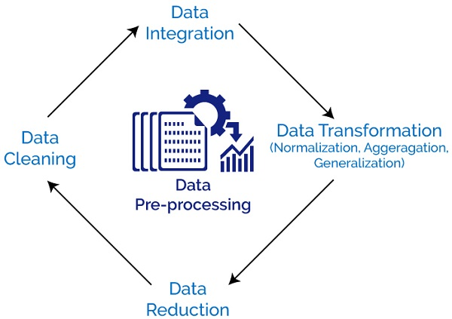
Cleaning and preparing data

Slide 34
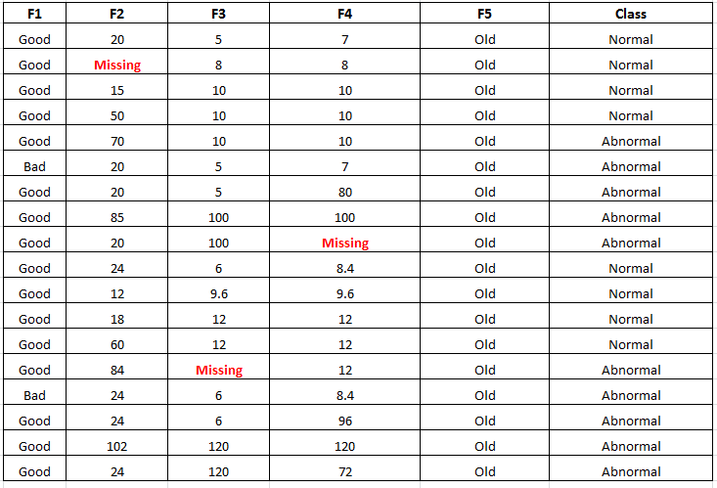

Slide 35
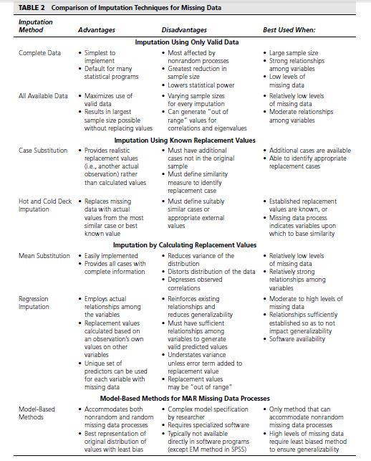

Slide 36
Logistic Regression

Slide 37
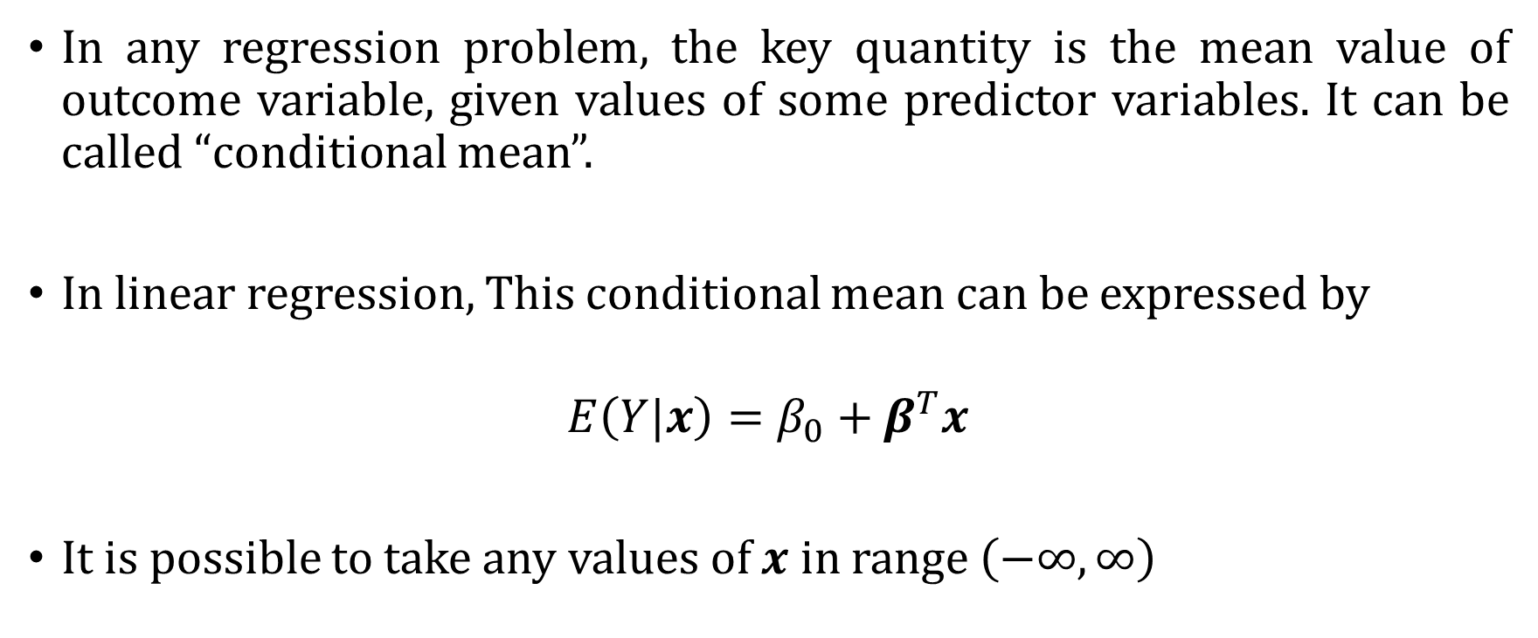
The Logistic Model
In any regression problem, the key quantity is the mean value of outcome variable, given values of some predictor variables. It can be called “conditional mean”.
In linear regression, This conditional mean can be expressed by
$$E\left(Y|x\right)=β_{0}+β^{T}x$$
It is possible to take any values of $x$ in range $\left(−∞,∞\right)$

Slide 38
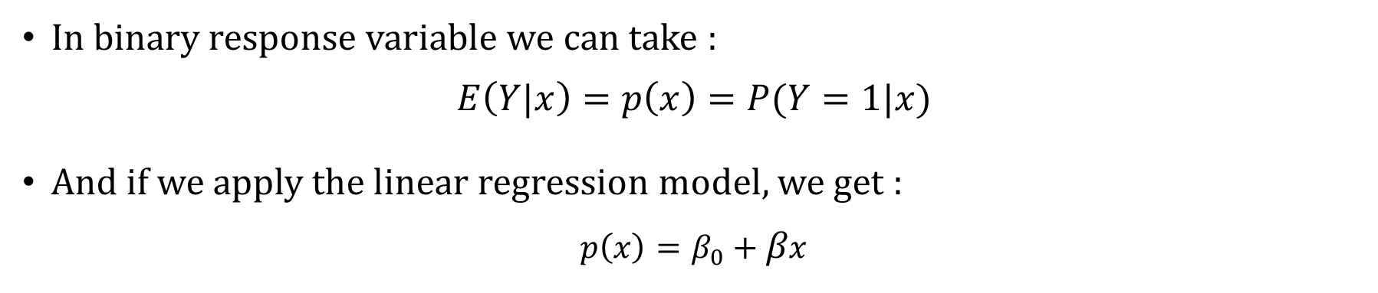
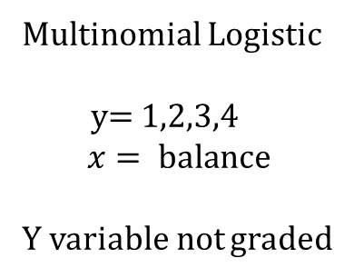
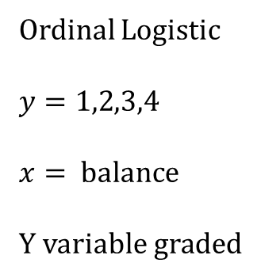
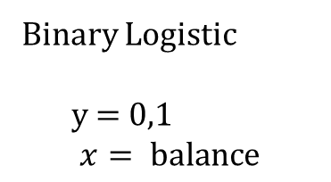
The Logistic Model
Binary Logistic
y = 0,1
$$x= \text{balance}$$
Ordinal Logistic
$y=1,2$,3,4
$$x= \text{balance}$$
Y variable graded
Multinomial Logistic
y= 1,2,3,4
$$x= \text{balance}$$
Y variable not graded
In binary response variable we can take :
$$E\left(Y|x\right)=p\left(x\right)=P(Y=1|x)$$
And if we apply the linear regression model, we get :
$$p\left(x\right)=β_{0}+βx$$

Slide 39
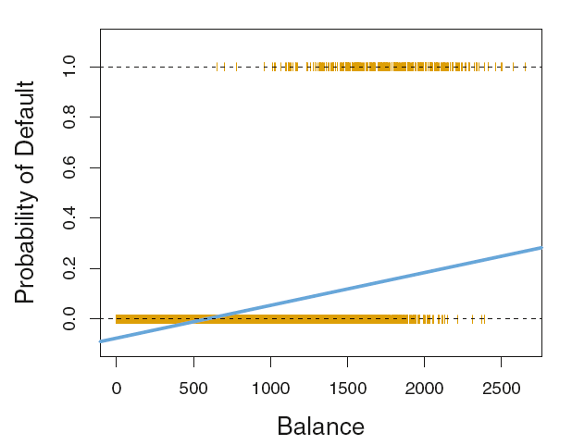
The Logistic Model
For very large (or small) balance, we will get values bigger than 1 (or smaller than 0)
Picture from: Intoduction to Statistical Learning

Slide 40
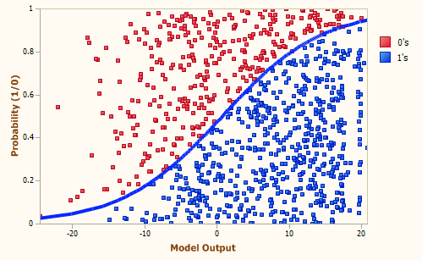

Slide 41
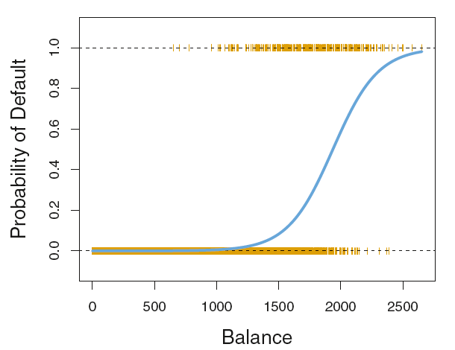

The Logistic Model
Logistic function gives the output of $p\left(X\right)$ between 0 and 1 :
$$p\left(X\right)=\frac{e^{β_{0}+βx}}{1+e^{β_{0}+βx}}$$
or equivalent with
$$\frac{p\left(X\right)}{1−p\left(X\right)}=e^{β_{0}+βx} \\ \log\left(\frac{p\left(X\right)}{1−p\left(X\right)}\right)=β_{0}+βxx$$
Picture from: Intoduction to Statistical Learning
log(odds) or logit

Slide 42
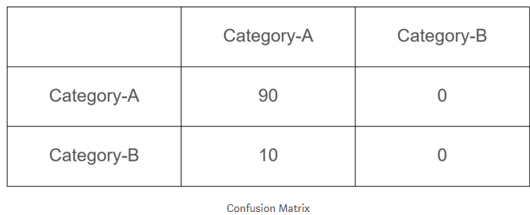
Imbalanced Dataset
Imagine, you have two categories in your dataset to predict
Category-A is higher than Category-B or vice versa (imbalance)
Imagine in a dataset of 100 rows, Category-A is containing 90 records and Category-B is containing 10 records. You run a machine learning model and end up with 90% accuracy. You were excited until you checked the confusion matrix.
Category-B is completely classified as Category-A and the model got away with an accuracy of 90%

Slide 43
Go to python notebook

Slide 44
More Method
Naïve bayes
https://medium.com/machine-learning-101/chapter-1-supervised-learning-and-naive-bayes-classification-part-1-theory-8b9e361897d5
https://medium.com/machine-learning-101/chapter-1-supervised-learning-and-naive-bayes-classification-part-2-coding-5966f25f1475
SVM
https://blog.statsbot.co/support-vector-machines-tutorial-c1618e635e93
Decision Tree
https://towardsdatascience.com/random-forest-in-python-24d0893d51c0
KNN
https://towardsdatascience.com/machine-learning-basics-with-the-k-nearest-neighbors-algorithm-6a6e71d01761

Slide 45
Data latihan
https://raw.githubusercontent.com/madmashup/targeted-marketing-predictive-engine/master/banking.csv

